Slide 1
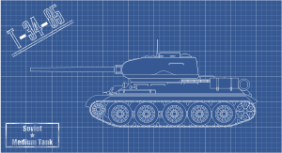
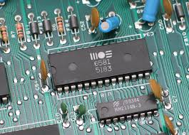
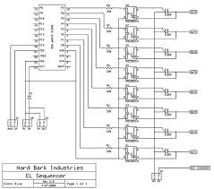

Design
Ch1
Ch2
Ch3
Ch4
Ch5
Ch6
Welcome
Lit. Review
Methodology
Design
Results
Introduction & Conclusions
4th part of the guided research track (GRT)
RRSG Seminar
Prepared by Dr. Simon Winberg
Notes:
This presentation was prepared for the ‘guided research track’ (GRT) for new grad students

Slide 2
Today’s Meeting plan
Short presentation (around 20mins) about the topic of Design, and considerations for writing the Design Chapter.
Snippets of designs from past years (mostly copied from past orals presentations)
Discussion of design issues
Q&A
See last slide for references. These may also be useful to help you prepare and write your design chapter.

Slide 3

Where should you be in your project at this stage?
You should already be into the stage of design
You should ideally be far past the requirements and specification phase, and even beyond the high-level design stage, and
You should be…
well into the implementation phase (and hopefully even some initial testing) of your projects at this stage.

Slide 4
Design
Design =
The creative process of developing a solution
A design is a detailed description of a solution
Tends to be a combination of technical language and design drawing (i.e. in ‘engineering speak’ / ‘design language’ )
Requirements:
Describes what is needed
Often in a language and using images that are accessible to the client / end-user (i.e. prepared in the ‘end user language’)
Specification:
A technical document that defines the product characteristics in detail.
Tends to be more technical language (i.e., ‘engineering speak’) but may need it in a form that is more widely sharable, e.g. accessible to a broader range of professionals

Slide 5
?
Requirements
vs.
Specification
vs.
Design

Slide 6


Requirements vs. Specifications
Requirements =
What is needed
They shouldn't state the ‘how’, but should rather state the ‘what’.
Specifications =
Document how
To achieve the requirements, and
Aspects to be satisfied in achieving a ‘what’ (the product) that satisfies the necessary criteria (as expected of professionals) such as: ethics, effective operation, safety (to users, environment, other systems, etc.), maintainability, etc.

Slide 7
Specification
A specification (or for software engineers) Software Requirements Specification (SRS) is:
A technical document details externally visible characteristics of the product.
A SRS is not the same as a statement of user needs.
The SRS can include
English text, Structured text, Diagrams
Tables, formulas, rules, etc. etc.
Structuring your specification details:
Environmental requirements: e.g. computer platform specifications, standards, interoperability needs, etc.
Non-functional requirements (the ‘-ilities’): usability, availability, security, efficiency, etc.
Feature specifications: a detail description of each feature
Use cases (use case elicitation): examples of how a user accomplishes a goal by using one or more features

Slide 8




Design: An interactive and iterative process
WHAT
WHY
…
Conceptual considerations
Characteristics
Functionality
Motivation for decisions made
Reasoning behind the design
Guiding principals
Literature
NEXT ISSUE
HOW
Technical design aspects
How system works / looks / fits together

Slide 9
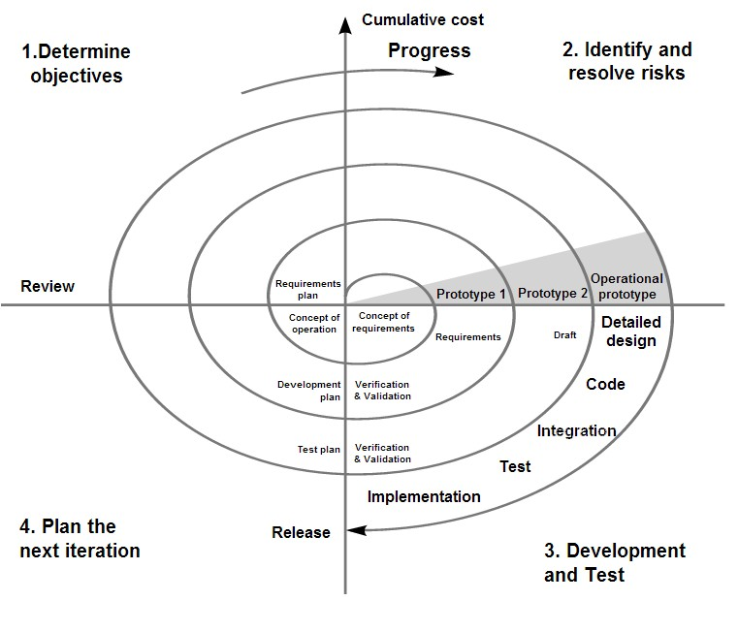
The spiral model of project development
Spiral model: The typical design process

Slide 10

The spiral model – where are you?
Spiral model: The typical design process
You should have:
Made an initial start on the prototype
IF NOT ALSO (and preferably so)
Completed an initial, e.g. paper-based concept sketch, and be working on a ‘real thing’
Where you are

Slide 11
Your Design Chapter
Overview
How the design chapter is structured
System Level / Top level design
Specification
Somewhat optional; depends what is to be done, and if more detail besides the requirements (usually in Ch1) is needed
Hardware Design / Circuit / PCB / Platform (whichever, if any, are relevant to the project concerned*)
Software Design (if relevant, incl. implementation snippets)
Integration Design
Testing infrastructure (for example you might set up some kind of testing infrastructure, e.g. for regression testing)
Maintenance Design
Subsections for each section of the chapter are elaborated in the report template
*Note that even if it is a software only project, you should still provide some information about the platform, computer system, operating system, etc. that it is being development on and/or the platform the application is to run on.

Slide 12

NB: Your Design should correspond To Your Objectives!
Try to show good consistency and integration between the chapters of your write-up
Remind the user or emphasize how particular design decisions or part link back to the requirements and to the main objectives
Make use of cross-references to help show the connectedness:
Keep your eye on the ball objectives
connect: objectives → requirements → specifications → design → testing → conclusions

Slide 13

Demonstration & discussion: Design Chapters from past BSc reports

Slide 14

Now over to you

Slide 15
Peer review of: Draft design work
Any Questions?

Slide 16

Assignment
(Due Next Thursday)
Prepare an outline of your Design Chapter
Aim at about two pages
Should have the sections and subsections
Possibly some point-form thoughts on what is going to go into each section if your sections/subsections don’t explain this clearly
A top-level/system design drawing

Slide 17

Ch1
Ch2
Ch3
Ch4
Ch5
Ch6
Welcome
Lit. Review
Methodology
Design
Results
Introduction & Conclusions
Questions?
Planning ahead:
Next week (last week of term) : no RRSG4thYears GRT meeting
Mid-term Vacation : no meeting
First week of term 4 : meeting
No meetings for a few weeks until
Three weeks before hand-in (meeting to be announced): meeting with presentation on GRT Results
Two weeks before hand-in: meeting about conclusions and the orals (then you are left to focus on your write-up until the due date)

Slide 18
Refs
Shari Pfleeger & Joanne Atlee. Software Engineering Theory and Practice. 3rd Ed. Prentice-Hall. 2006.
Barry Boehm. “Spiral model of software development and enhancement”. In Computer 21.5. 1988: 61-72.
Cross, Nigel. Engineering design methods: strategies for product design. John Wiley & Sons, 2008.
Henzinger, Thomas A., and Joseph Sifakis. “The discipline of embedded systems design.” Computer 40.10 (2007): 32-40.
Kopetz, Hermann. Real-time systems: design principles for distributed embedded applications. Springer. 2011.

